Slide 1
Understanding URLs

Slide 2
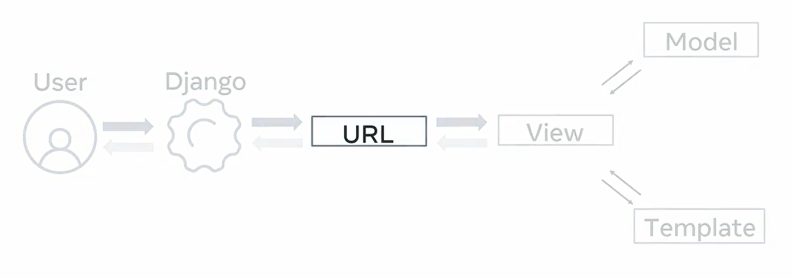

Slide 3
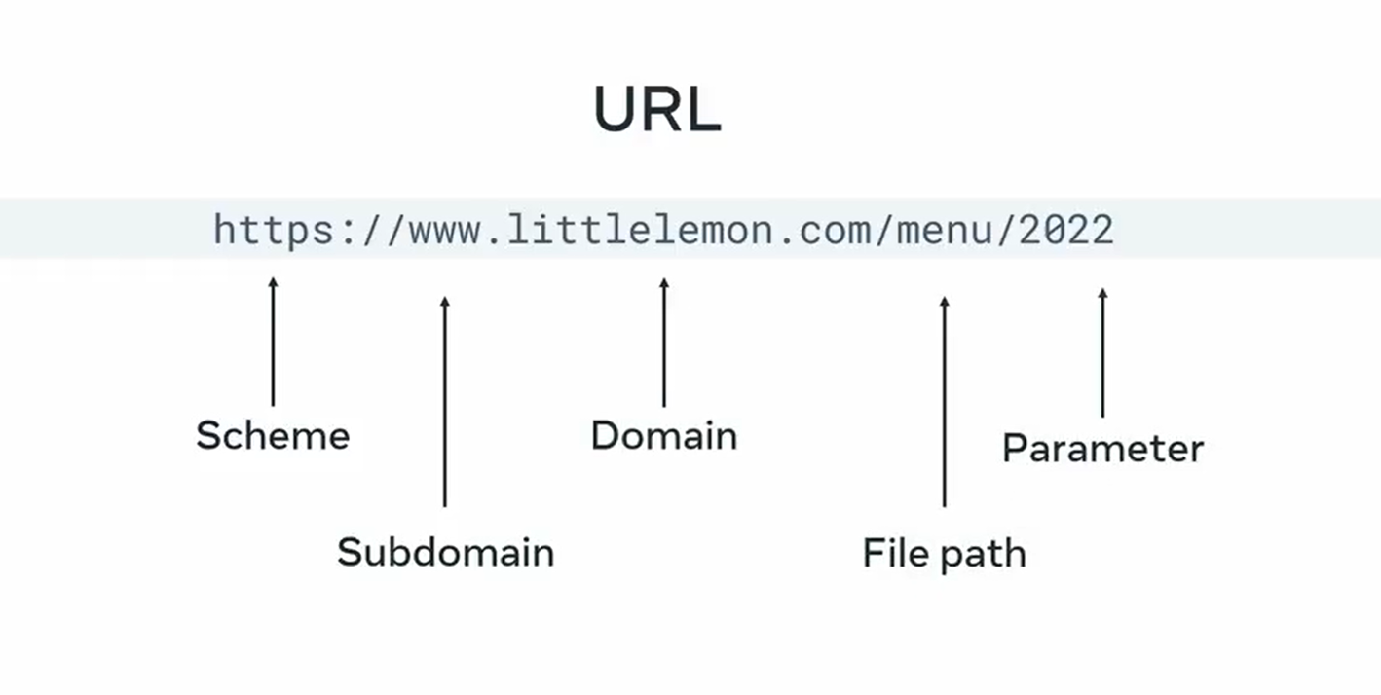

Slide 4


Slide 5
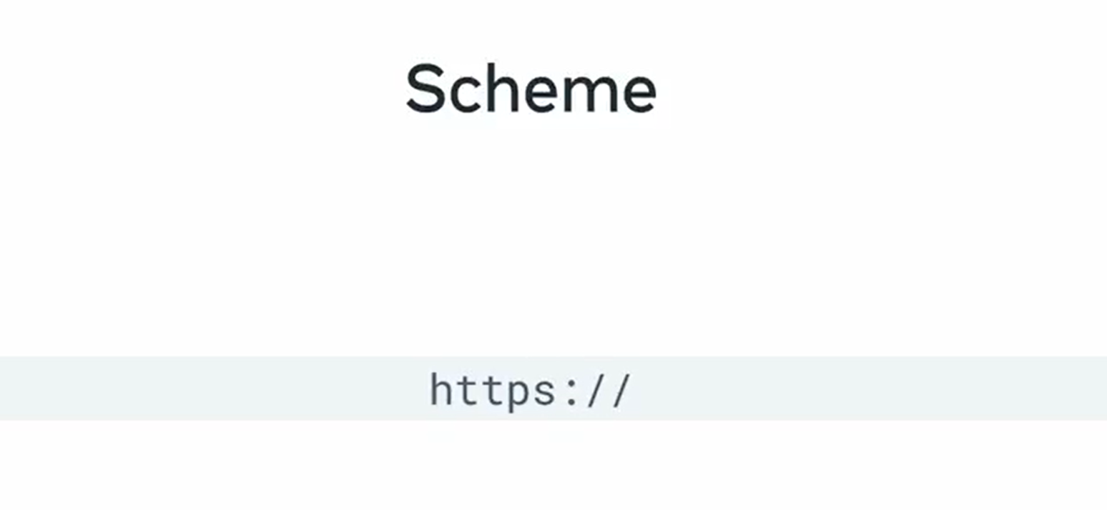

Slide 6


Slide 7


Slide 8


Slide 9
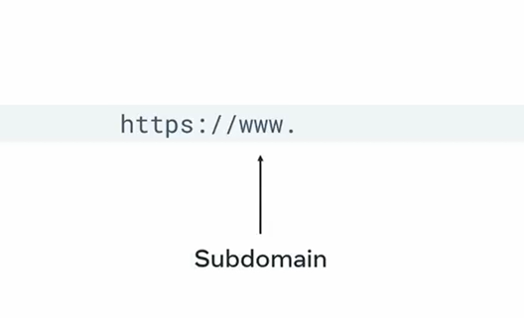
Subdomain

Slide 10
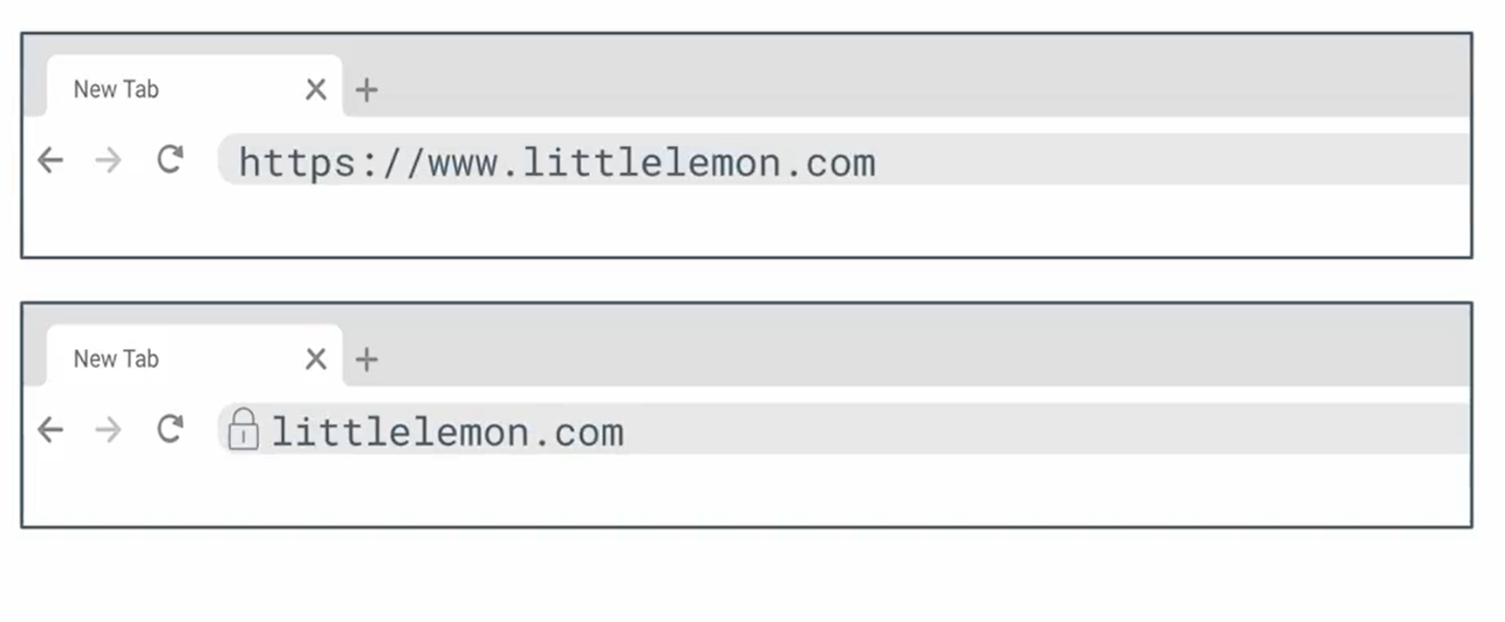

Slide 11
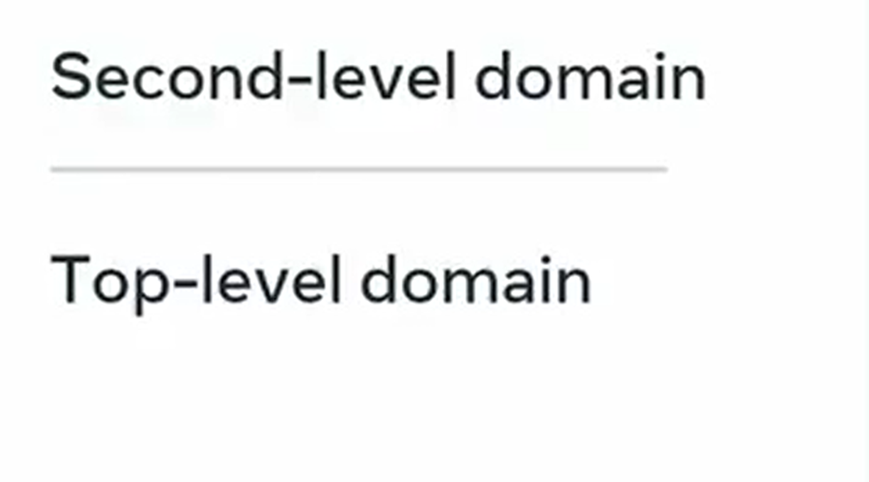

Slide 12
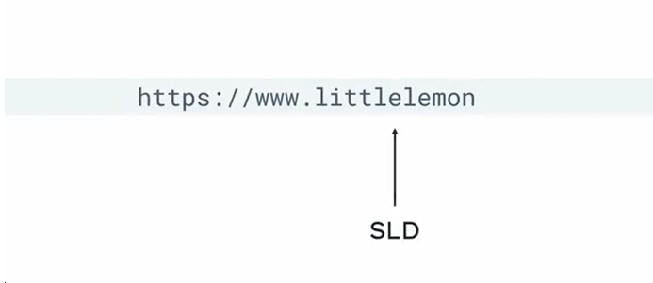
Second-level domain

Slide 13
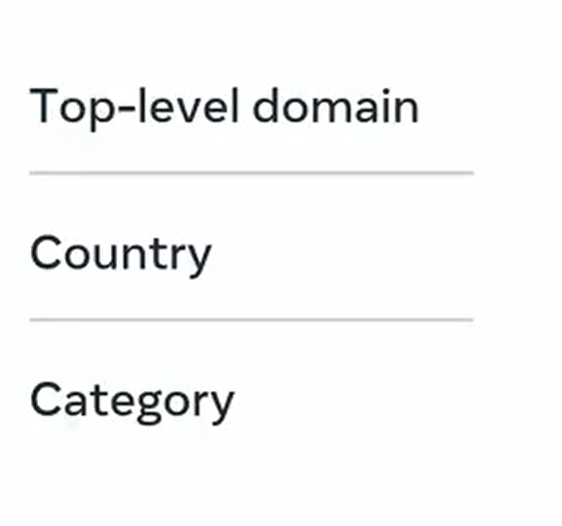

Slide 14


Slide 15
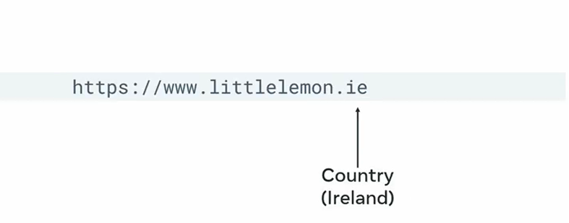
Top-level domain

Slide 16


Slide 17


Slide 18

URL file path

Slide 19


Slide 20

URL parameters

Slide 21

Query Strings

Slide 22
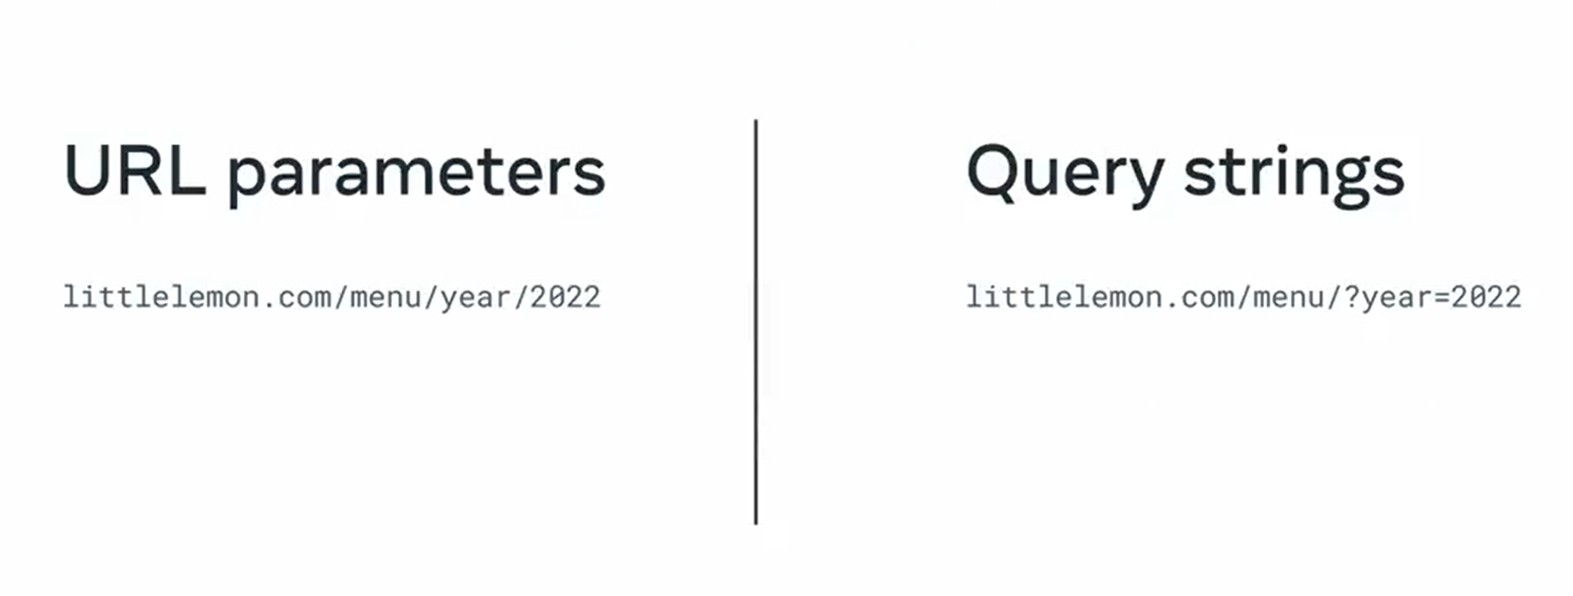

Slide 23
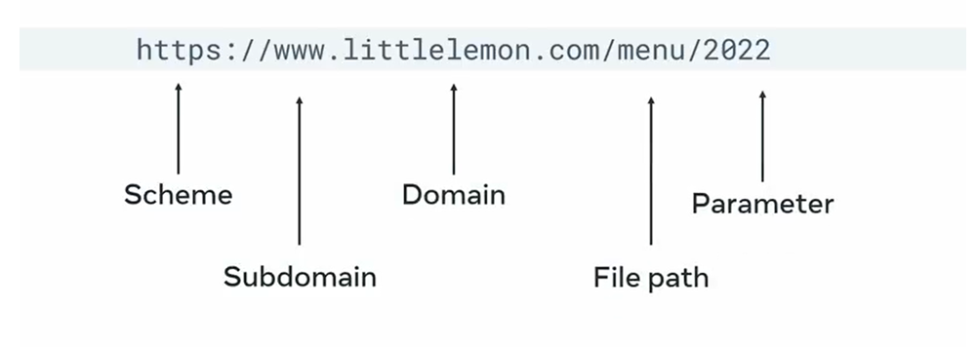
URL

